Slide 1
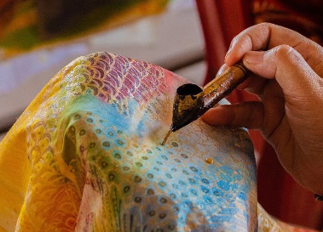
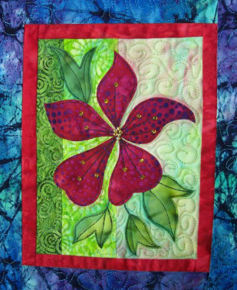
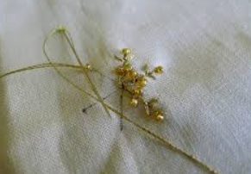
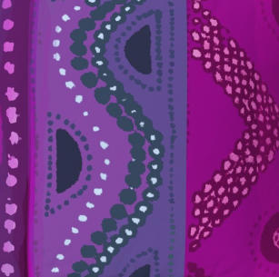
Year 5
Textiles.
DT Knowledge Organiser
Key Knowledge and Skills | Evaluate | Vocabulary
To use the internet for research and design ideas. | How are innovative products made? | Sew/ Stitch | Join, fasten, or repair by making stitches with a needle and thread or a sewing machine
Create your own design criteria.
 |  | Aesthetics | Beauty or art, and people's appreciation of beautiful things.
Use selected tools/equipment with a good level of precision.
 | How sustainable are the materials in the products?
 |  | Functionality | The quality of being suited to serve a purpose well.
Create and follow a detailed step-by-step plan.
 |  | Appliqué | Pieces of fabric are sewn or stuck on to a larger piece to form a picture or pattern.
Mainly accurate measure, mark out, cut and shape materials/components.
 | What methods of construction have been used in an existing product?
To create a simple 3D product using pattern pieces and a seam allowance. | Is your design fit for purpose?
 |  | Stitch | A loop of thread from a single movement of the needle in sewing, knitting, or crocheting.
To know that a 3D textiles product can be made from a combination of fabric shapes. | Is the end product like your original design?
 |  | Batik | A method of coloured designs on textiles by dyeing them, having first applied wax to the parts to be left undyed.
To experiment with a range of media to overlap to create interesting colours, textures and effects. | What did you find a challenge?
 |  | Texture | The feel, appearance, or consistency of a surface or substance.
To experiment with batik.
Outcome – To design and make a Caribbean Batik square.

