Slide 1
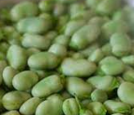
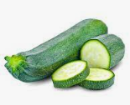
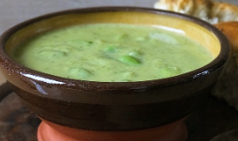
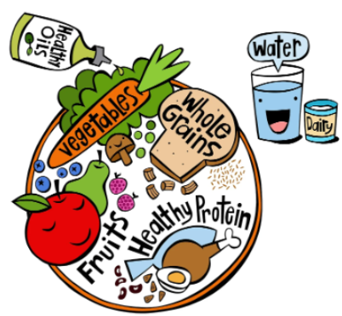
Year 6
Cooking and Nutrition .
DT Knowledge Organiser
Key Knowledge | Evaluate | Vocabulary
Prepare vegetables safely using appropriate utensils. | Did I weigh out my ingredients accurately so that my soup tasted nice? | Micro organism | A group of very small life forms, like bacteria
Follow a recipe carefully.
 |  | Hygiene | Keeping yourself and your surroundings clean.
Assemble and cook ingredients by controlling temperature of the hob. | Did I cook it for the correct amount of time?
 |  | Simmer | To keep the water or food that is being heated just below boiling point and bubbling gently.
Measure ingredients accurately and calculate ratios to scale up or down from a recipe. | Did I use the preparation techniques; soak, simmer and garnish?
 |  | Ratio | To increase or decrease amounts.
Create and refine recipes by changing ingredients / temperature / cooking methods / cooking times | Would I change anything about my finished recipe to improve it?
 |  | Seasonality | Fresh food that is ready to eat during its harvest season.
Understand the importance of correct storage and handling of ingredients linking knowledge of micro organisms from science. | Would you consider your dish to be balanced?
 |  | Balanced meal | Eating a variety of different foods from all five food groups to maintain a healthy diet
Evaluate the product discussing the benefits of a healthy bean soup. | Why do you think your soup is / is not balanced?
 |  | Season | To add salt, herbs, pepper or other spices to food to make it taste better.
Outcome
To design, make and evaluate a broad bean and courgette soup from seasonal homegrown produce.

