Slide 1
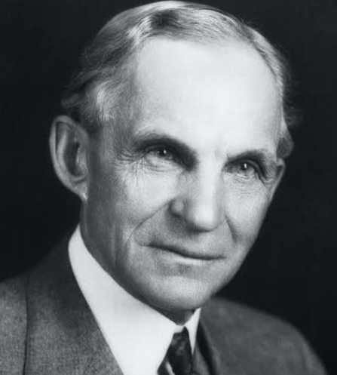
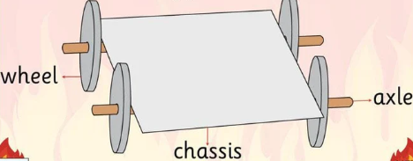
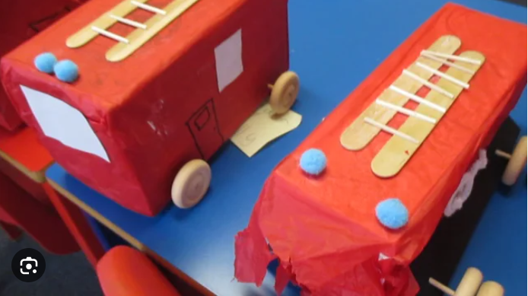
Year 2
Structures and Mechanisms
DT Knowledge Organiser
Key Knowledge and Skills | Evaluate | Vocabulary
To say how their products will work. | What did I like about my product? | Mechanism | A system of parts moving together (often in a machine)
Use simple design criteria to help develop their ideas.
 | Would I use any different materials next time? Why/why not?
Develop and communicate ideas by talking and drawing. |  | Axis | A real or imaginary line going through the centre of an object which spins.
 |  | Axle | A pin or shaft on or with which a wheel or pair of wheels revolves.
Select from a range of tools and equipment, explaining their choices.
 | Is there anything I didn’t like about my product?
 |  | Dowel | A small, thin piece of wood.
 | What could I do to make my product better? | . | The supporting frame of a structure.
To know about the movement of simple mechanisms such as wheels and axles.
 |  | Rigid | Stiff or fixed – not being able to move or bend.
To use the correct technical vocabulary for the projects they are undertaking.
 |  | Base | The lowest part or edge of something, especially the part on which it rests or is supported.
 | What would I do differently next time?
Engineer to look at – Henry Ford. He invented several vehicles.
Outcome – To
design and make
a fire engine.

