Slide 1
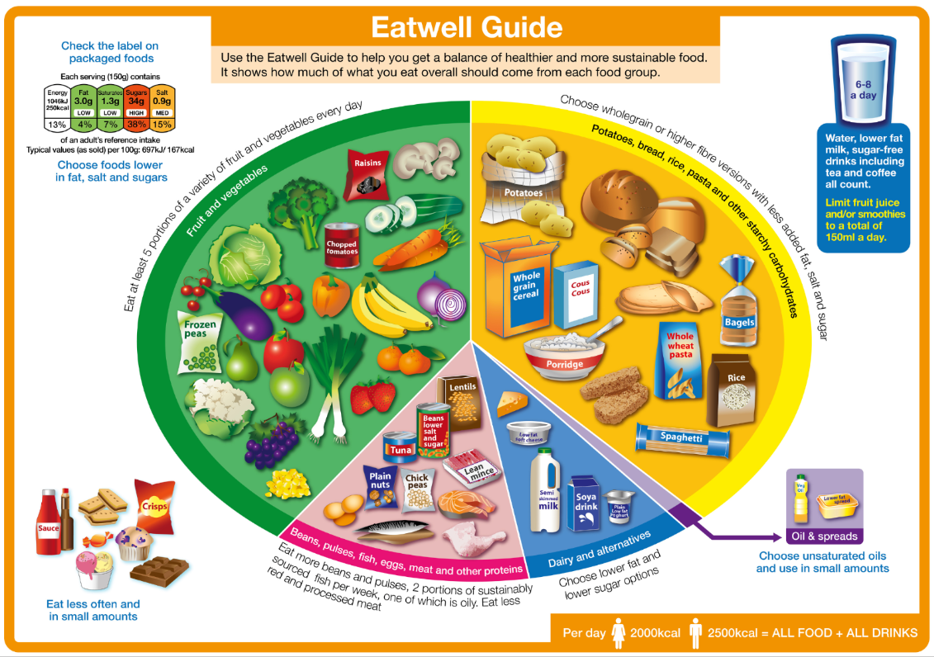
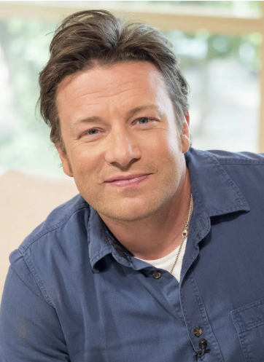
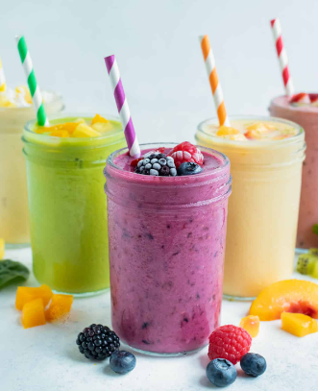
Year 3
Cooking and Nutrition
DT Knowledge Organiser
Key Knowledge and Skills | Evaluate | Vocabulary
Generate realistic ideas, focusing on the needs of the user. | I can say how well existing products have been designed and made. | Food Group | Different foods belong to a specific group. E.g. meat is in the protein group.
To understand that a healthy diet is made up from a variety and balance of different food and drink, as depicted in The Eatwell Plate. | I can say where and when existing products were designed and made.
 |  | Balanced Diet | Diet which has all of the right kinds of food for being healthy.
To work safely and hygienically to join and combine a range of ingredients. | To evaluate their completed product against the given design criteria.
 |  | Healthy Plate | A simple guide to encourage you to eat healthily.
To prepare foods by slicing, mixing, grating and weighing.
 |  | Slicing | Cut something (a food) into slices.
Understand the food hygiene procedure after cooking – clean down surfaces, put ingredients away, wash equipment and dry equipment. |  | Measuring | To measure the quantity you need.
 |  | Grating | Substances that are found in foods that the body needs to keep healthy.
Chef to look at - Jamie Oliver.
Outcome – Design
and make a
nutritious fruit
Smoothie.

