Slide 1
Year 5 Parent meeting
16th September 2021

Slide 2
Key information and dates
PE days are Wednesday and Friday for this term – trainers are needed. Please remove earrings on these days.
Check the school website pages and twitter for regular updates about our work in class (@Hawthorn_PS)
If you ever have a question or concern, speak to us!

Slide 3
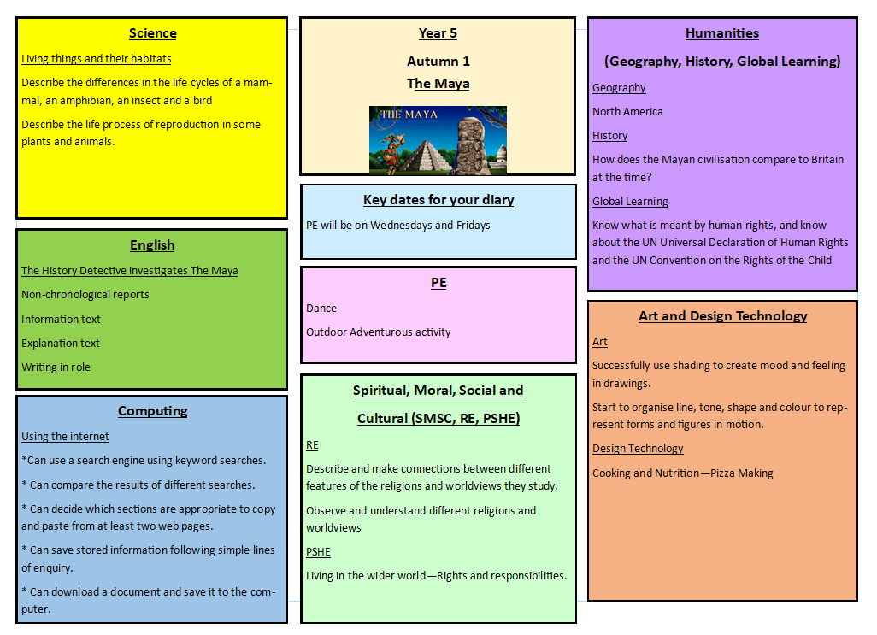
Our topic this half-term

Slide 4
Reading
Reading bags will go home every night
Each child has a book to read – they should read every night to improve their skills.
If they want to read their own book from home, that is fine.
All reading should be recorded in their reading record.
Any other information we want to pass onto you will also be in their reading bags, so it is worth checking the bags frequently.

Slide 5
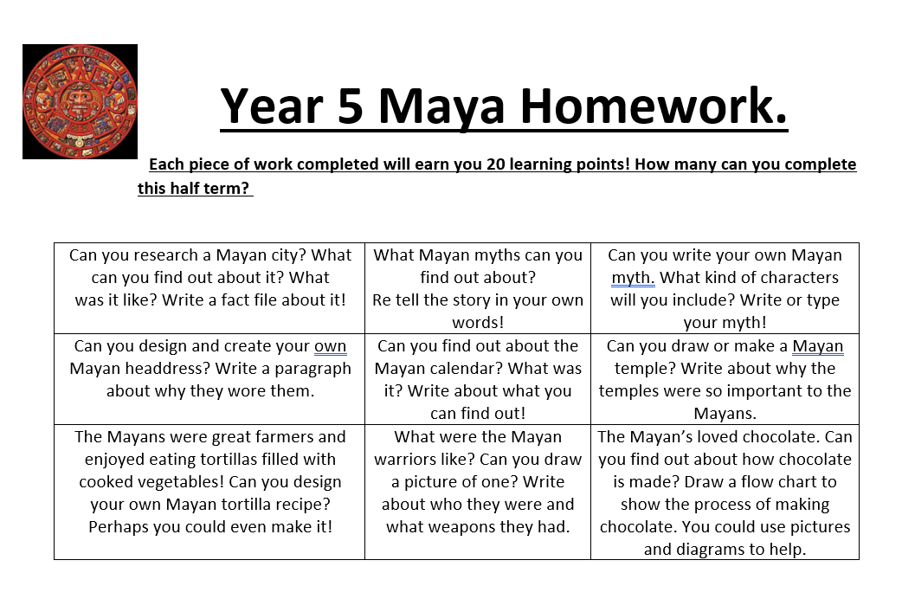
Homework
Children also have logins for TTRockstars to practise multiplication skills.
All children have been provided with a code to access seesaw at home.

